Slide 1

The Growing International focus on Inclusive and Sustainable Well-being and the Contribution of the Expert Group on Well-being Measurement
Richard Heys

Slide 2
Our Journey
2022 Sprint Series – What is ‘Beyond GDP’?
The Research Prospectus
Expert Group for Wellbeing Measurement
2023 Sprint Series – How are we delivering ‘Beyond GDP’?
2024 UNSC Report
The Expert Group will:
Accommodate diverse communities and methods and synthesize a consensus on the contents of the Framework for Inclusive and Sustainable Well-being (FISW), whilst recognizing the imperative of a streamlined set of metrics which best meet user need.
Commission, review and propose to the United Nations Statistical Commission a draft text of the FISW for consultation and testing.
Commission appropriate pilot compilation of statistics and data, from a diverse range of countries to fully explore suitability and feasibility. Pilot exercises which demonstrate the capacity of NSIs with limited resources to deliver should be prioritized.
Develop a communications strategy to aide uptake and appropriate usage of the data made available. User and producer interest is vital to secure access to well-informed resources with the required skills and knowledge to make this proposal a reality.
UN Expert Group on Well-being Measurement

Slide 3
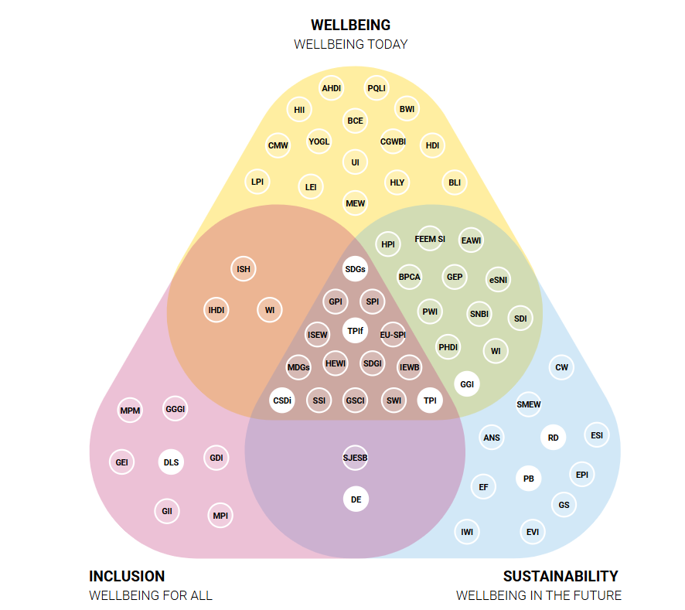
Key lessons from the sprints
Huge amount of international work, there has been no lack of effort…
…but the key outstanding gap is bringing together a standardised consensus which is widely and uniformly used.
There are a number of key dimensions which are widely used in conceptual frameworks…
…and it is feasible to bring these together.
However, some key questions remain to be resolved.
UN Expert Group on Well-being Measurement https://beyond-gdp.world/wise-database/wise-metrics

Slide 4
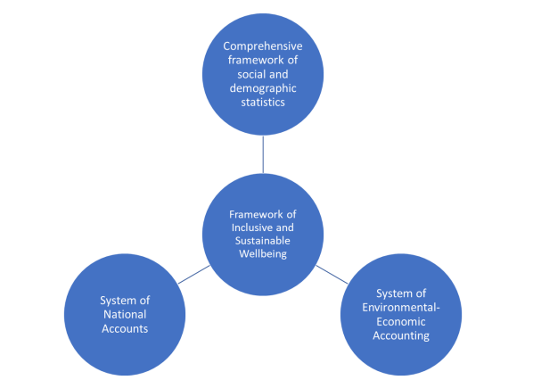
Placing the Framework for Inclusive and Sustainable Well-being at the centre of the existing data landscape
UN Expert Group on Well-being Measurement

Slide 5
Established Task-teams
Templates and Chapter Designs
Where and How to use Composite Indicators
Work
Health
Environment
Education
Digital well-being
Subjective well-being
UN Expert Group on Well-being Measurement

Slide 6
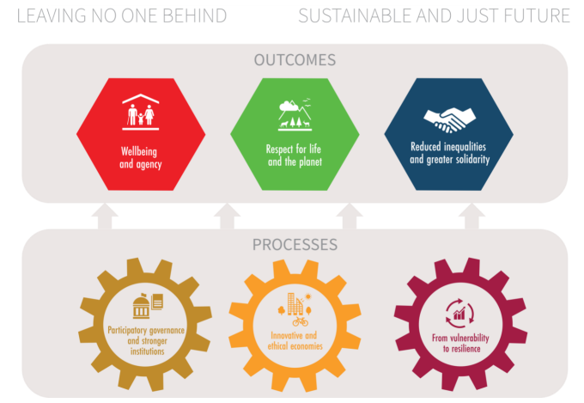
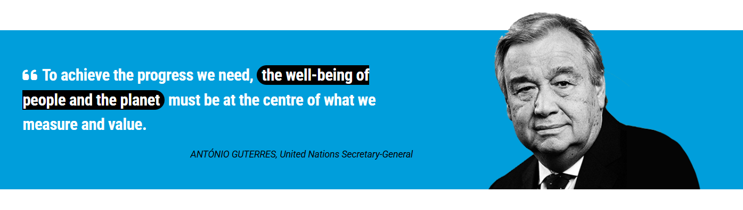
Fitting with the High Level Expert Group on Beyond GDP
Strategic alignment – what will we do, what will they do?
Prioritised workload – ensuring we support the High Level process
Need to reflect HLEG’s findings in our work
Interim report available - https://www.un.org/en/beyondGDP/documents
UN Expert Group on Well-being Measurement

Slide 7
HLEG Interim Report
A proposal for a high-level dashboard comprising seven areas (the precise metrics are still up for debate but some examples are highlighted):
Material Well-being – household income/consumption, opportunity and job quality, time use and access to leisure, and economic security (access to housing, the internet, and safety nets).
Health – maternal and childhood health, healthy life expectancy, chronic disease rates.
Education – access to pre-school, high school, and higher education, having knowledge and skills to participate in the labour market and social life.
Environmental Quality – clean air and water, absence of pollutants, loss of biodiversity.
Subjective Well-being – life satisfaction, meaning/purpose, hope, agency, emotional states, satisfaction with mental/physical health, perceptions of safety, trust, and governance.
Social Capital – sense of belonging, ability to participate, friends or family to rely on when in need.
Governance – safety and security, ability to participate in societal decisions and activities, absence of discrimination
A proposal for additional extended / adjusted GDP metrics, which would sit beside our existing GDP and extended GDP metrics like inclusive income:
vGDP – a version of GDP removing goods and services which can be considered ‘bads’ – weapons, cigarettes – or ‘reactions to bads’ – e.g locks and barbed wire, and which do not add additional value on their own.
eGDP – a version of GDP which makes adjustments for inequality – so the more unequal the country the lower the eGDP number will go
sGDP – a version of GDP to account for sustainability – which I read to mean adjusting market prices for the impact of externalities (e.g. shadow prices). This is clearly the most difficult given such shadow prices do not exist.
UN Expert Group on Well-being Measurement

Slide 8
Can we provide a link between the HLEG and existing statistical domains, within the Valuing What Counts landscape?
HLEG
‘Dashboard’
FISW: a conceptual framework
to identify a consistent range of
headline indicators per domain to
bridge between HLEG dashboard
and the wider statistical landscape
Data from statistical domains
Seven Guiding Stars
Constellations
Galaxies
UN Expert Group on Well-being Measurement

Slide 9
Proposed Timeline
The timetable for delivery of Version 1, therefore, is as follows:
September 2025 – March 2026: identification of preferred metrics to populate bridging tables by task-teams
September 2025 – January 2026: parallel development of chapter templates
January 2026: EGWM signs off chapter templates and proposed bridging tables
March 2026: expected HLEG final report
March 2026 – June 2026: EGWM to reflect on alignment with HLEG outcomes and General Assembly conclusions, comparing proposed bridging tables to HLEG report requirements
June 2026: Sign-off by EGWM of FISW design to permit development of draft chapters by task-teams.
June 2026 – September 2026: development of draft chapters by task-teams, incorporating feedback
September 2026: Sign-off by EGWM of draft chapters for consultation
October 2026 – November 2026: global consultation on draft chapters
December 2026: final revision of chapters.
January 2027: sign-off of finalized version one FISW by EGWM to UNSC.
UN Expert Group on Well-being Measurement

